Slide 1


Slide 2


Mini Secure Authentication System
Final Year Project Synopsis
Submitted by
ROLL | NAME
2201010055 | HITESH KUMAR
2201010056 | AMIT RAJ
Industry Mentor:
Faculty Mentor:
Notes:
New Courses replaced with New Programmes

Slide 3
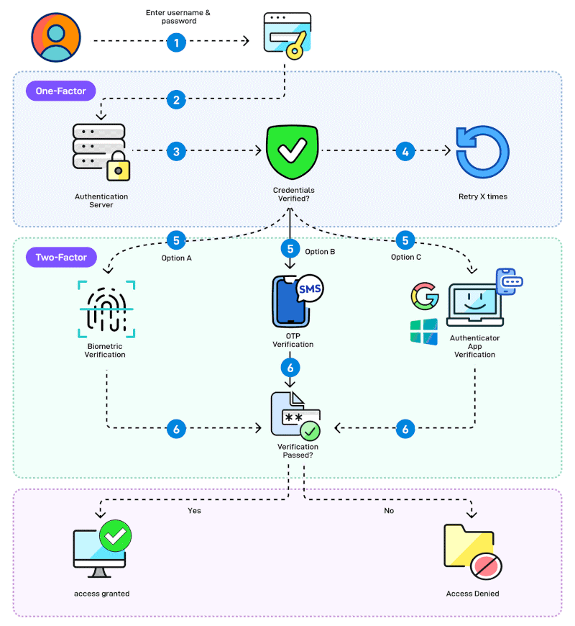

Project Overview
The Mini Secure Authentication System is designed to secure user login and identity verification.
It protects user credentials using cryptographic password hashing techniques.
The system includes Multi-Factor Authentication (MFA) for an additional security layer.
Role-Based Access Control (RBAC) is used to manage and restrict user permissions.
Token-based session management ensures secure and controlled user sessions.
Notes:
New Courses replaced with New Programmes

Slide 4
Specific Objectives
To design a secure authentication system for protecting user identities and system resources.
To securely store passwords using cryptographic hashing techniques.
To implement Multi-Factor Authentication (MFA) for an additional layer of security.
To enforce Role-Based Access Control (RBAC) to restrict access based on user roles.
To manage user sessions securely using token-based authentication.
Notes:
New Courses replaced with New Programmes

Slide 5
Key Features
Secure Password Hashing – Passwords are stored using cryptographic hashing (no plaintext storage).
Multi-Factor Authentication (MFA) – Adds an extra verification step during login.
Role-Based Access Control (RBAC) – Users can access only authorized resources based on roles.
Token-Based Session Management – Secure handling of user sessions without repeated logins.
Cryptography-Based Security – Uses standard encryption techniques to protect sensitive
Notes:
New Courses replaced with New Programmes

Slide 6
Project Usecases & Scope
Project Use Cases:
Secure user registration and login for web and software applications.
Protected access control for different user roles (Admin / User).
Secure session handling for authenticated users using tokens.
Prevention of unauthorized access, credential theft, and misuse.
Project Scope:
Applicable to academic projects, web applications, and small-scale systems.
Can be extended to support enterprise systems, cloud platforms, and APIs.
Scalable for future enhancements like biometric authentication or advanced MFA.
Provides a reusable authentication framework for real-world security implementations
Notes:
New Courses replaced with New Programmes

Slide 7
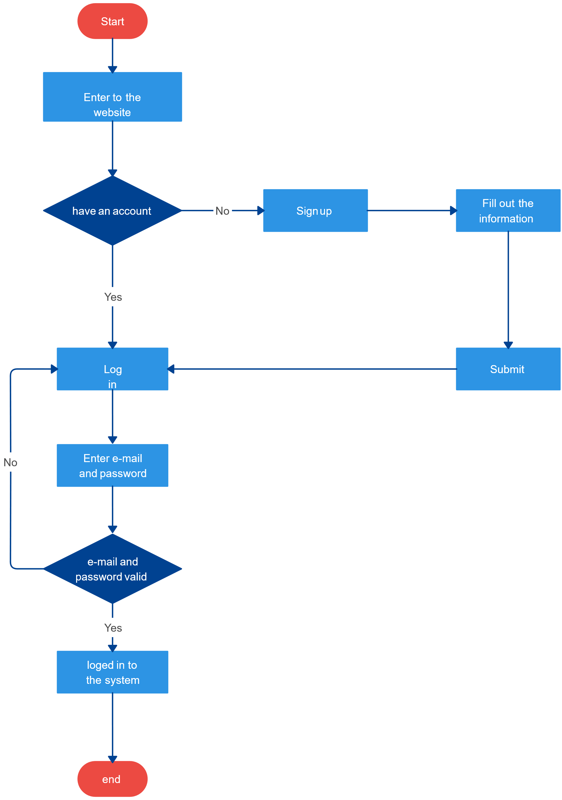
Prototype/Project Flow diagram/Architecture
1.User Registration
User enters credentials.
Password is hashed using SHA-256 and stored securely.
2.User Login
User enters username & password.
3.Multi-Factor Authentication (MFA)
One-Time Password (OTP) is generated.
4.Role-Based Access Control (RBAC)
User role (Admin / User) is checked.
5.Token-Based Session Management
Secure token is generated.
Notes:
New Courses replaced with New Programmes

Slide 8
Data & Resources
1.Data Sources
User input data such as username, password, and role information collected during registration and login.
Authentication data including hashed passwords, OTPs, and session tokens generated by the system.
2.Databases
Lightweight database to store user credentials, roles, and authentication tokens securely.
Passwords are stored only in hashed format, not in plaintext.
3.Software & Tools
Python for implementing authentication logic and security modules.
Cryptographic libraries for hashing and encryption (SHA-256, AES, RSA).
Development tools such as VS Code and local server environment for testing.
4.Hardware
Standard PC/Laptop used for development and testing.
No specialized hardware required.
Notes:
New Courses replaced with New Programmes

Slide 9
Methodology
Approach Used:
A layered security approach is used to protect user authentication.
Cryptographic techniques secure user credentials and sensitive data.
Multi-Factor Authentication and Role-Based Access Control ensure controlled and secure access.
Token-based session management maintains secure user sessions.
Programming Language: Python
Cryptography: SHA-256 (hashing), AES & RSA (encryption)
Authentication: Multi-Factor Authentication (OTP)
Authorization: Role-Based Access Control (RBAC)
Session Handling: Token-based authentication
Development Tools: VS Code, Local Server Environment
Notes:
New Courses replaced with New Programmes

Slide 10
Expected Results & Impact
The system provides a secure authentication framework using cryptographic techniques.
User credentials are safely stored and verified, reducing the risk of password leakage.
Multi-Factor Authentication adds an additional security layer during login.
Role-Based Access Control ensures authorized access based on user roles.
Token-based session management enables secure and efficient session handling.
The system minimizes unauthorized access and privilege misuse.
Overall, the project improves data security, system reliability, and user trust.
Notes:
New Courses replaced with New Programmes

Slide 11
Project Timeline
Phase 1: Requirement Analysis & Design
Duration: Week 1
Understanding authentication requirements and Designing architecture
Phase 2: Core Authentication Development
Duration: Week 2
User registration and login module and Password hashing using cryptographic techniques
Phase 3: Security Enhancements
Duration: Week 3
Multi-Factor Authentication (MFA) implementation and Role-Based Access Control (RBAC)
Phase 4: Session Management & Integration
Duration: Week 4
Token-based session handling and Module integration and optimization
Phase 5: Testing & Documentation
Duration: Week 5
System testing and validation
Notes:
New Courses replaced with New Programmes

Slide 12
THANK YOU

